Slide 1
DRUG ADDICTION ESCAPE
Prepared by:
Mohammad basil ali khan
Abdul ahad shaikh
Syed Jodat ali Naqvi
Inam abbasi

Slide 2
Motivation:
Drug Use Rising
Between 2010-2019 the number of people using drugs increased by 22 per cent
Most common young generation
Its can be helpful for those who hesitate to spoke to someone about it

Slide 3
What should we know?
What is drug addiction?
Signs of drug ADDICTION
What are its causes?
What is its scope?

Slide 4
What is Drug Addiction ?
Addiction is an inability to stop using a substance or engaging in a behavior even though it is causing psychological and physical harm.
Drug addiction is a disease that negatively affects a person’s brain and behavior.
A person can become obsessed with any legal or illegal drugs.
Nicotine, marijuana and alcohol are commonly misused drugs in today’s world.

Slide 5
Signs of addiction
most obvious sign of an addiction is the need to have a particular drug or substance
Psychological signals:
Physical signals:
use of drugs or alcohol as a way to forget problems or to relax
mood swings, anxiety, anger, or depression
withdrawal or keeping secrets from family and friends
feeling shaky or sick when trying to stop
needing to take more of the substance to get the same effect
changes in eating habits, including weight loss or gain

Slide 6
Causes
Exposure to a peer group that tolerates or encourages drug abuse
An action performed once as an experiment in a social situation can soon develop into a habit
History of abuse or neglect
Club drugs are commonly being used at clubs, concerts and parties
Easy availability of alcohol and drugs

Slide 7
What is its scope?
According to the United Nations Office on Drugs and Crime, Pakistan has 6.7 million drug users. Almost 2 million of these are addicts, amongst the highest number for any country in the world.
The exact number of people on heroine in the USA is unknown but according to survey on drug abuse 2 million people in the United States have abused heroine. Those who have used Mariguana is around 43 million; hallucinogens 10 million and simulates 13 million
Unhealthy drug use is resulting in over 100,000 deaths each year and costing society over 185 billion dollars annually

Slide 8
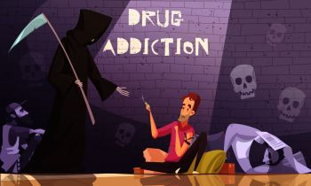
IN THE END.....!
-ILL Health -SICKNESS
-ultimately death
Only 10% of these people are treated. Even if we manage to save 1% of the total population through this application, it will be a win for us.

Slide 9
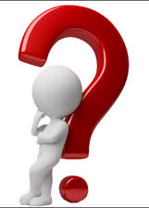
Want to quit but…. How?

Slide 10
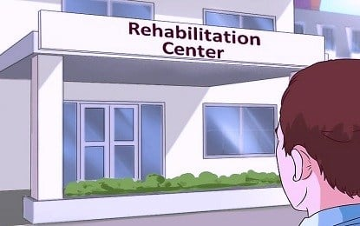
HOPE….
Rehabilitation becomes essential when an individual loses direction into the wrong path and needs to be brought back to the right one.

Slide 11

PROBLEM…..!
LOG KYA Kahenge
Complications with employment leave.
Insurance coverage

Slide 12
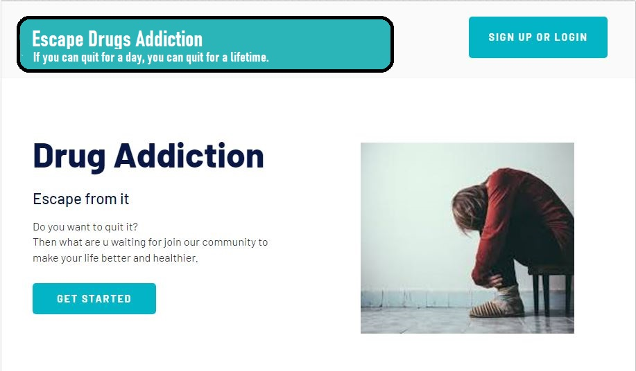
SOLUTION…..

Slide 13
FLOW…..
Result
Therapy session
Answer the Questions
Sign up or login

Slide 14
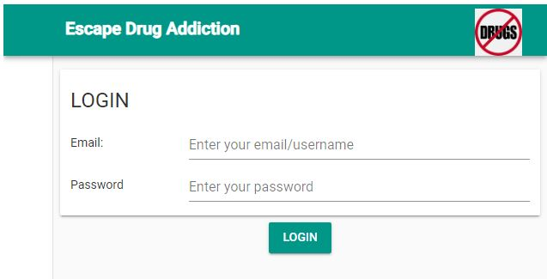
Special features of app…..
Login in account using your email ID and password.
This process will secure the info of user.

Slide 15
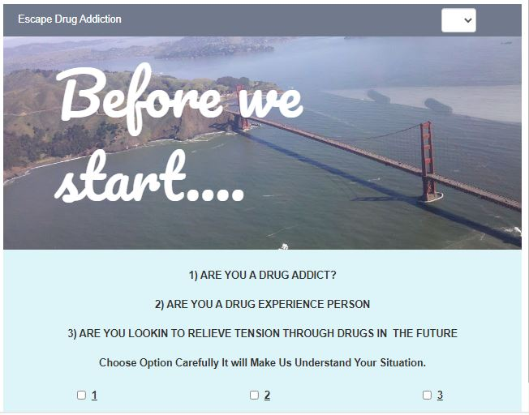
categorizing users
- Each user could categorize his/her account according to their status as an addict, or a person willing to help others

Slide 16
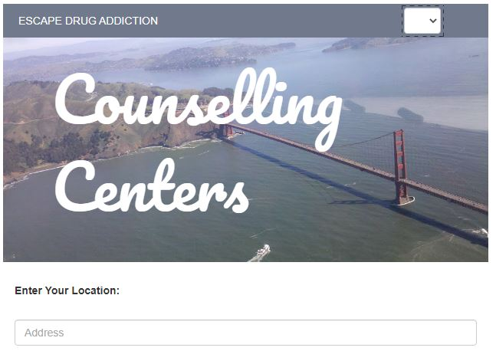
People near you
- By this feature App will suggest you people by which you may want to create your therapy group.

Slide 17
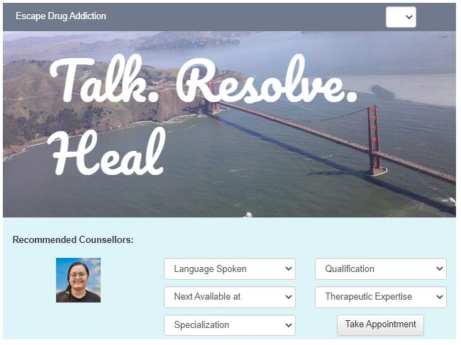
selecting counsellors
- Patients/Clients can select the most suitable counsellor keeping their problems and counsellor's education and rating in mind

Slide 18
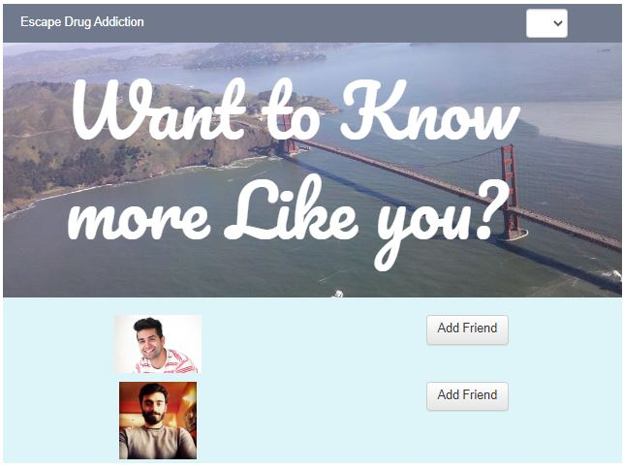
CREATE YOUR CIRCLE
- This app have feature that you can create your therapy circle by your own choice.

Slide 19
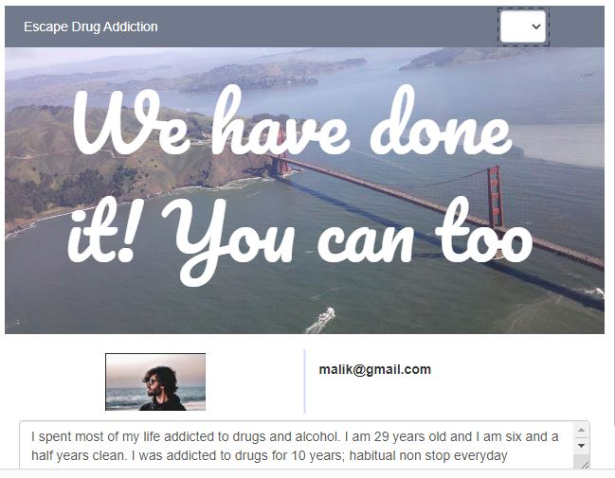
You can do it…!
- If you are failing to quit the addiction, you will then be guided by former addicts which will also help you in restarting the journey with fresh mindset

Slide 20
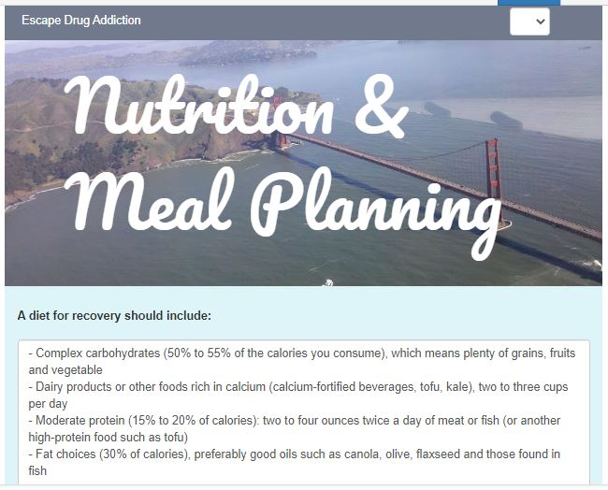
The Connection between Diet & Addiction
Drugs reduce the body’s ability to properly absorb vitamins and minerals. This not only increases the risk of developing nutritional deficiencies but also increases the risk of developing other health problems.

Slide 21

we are evolving
As per our clients feedback, we are are consistently evolving and improving our healing or therapy sessions. Usually after every 3-4 months we run improvement procedure on our programs

Slide 22


